Slide 1
Change Schema

Slide 2
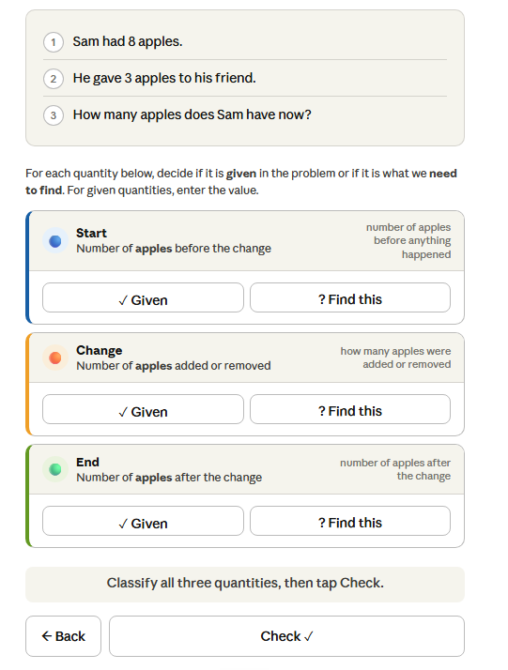
1. Identify Variables

Slide 3
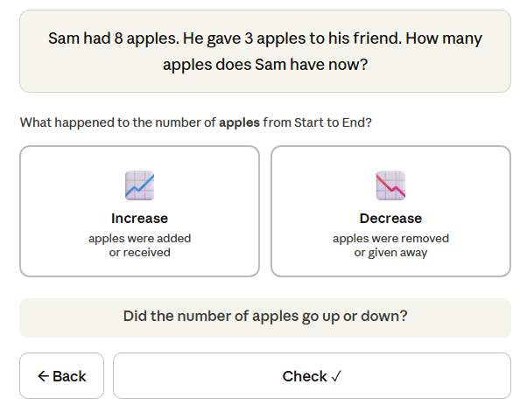
2a. Identify the change
(Did the quantity increase or decrease?)

Slide 4
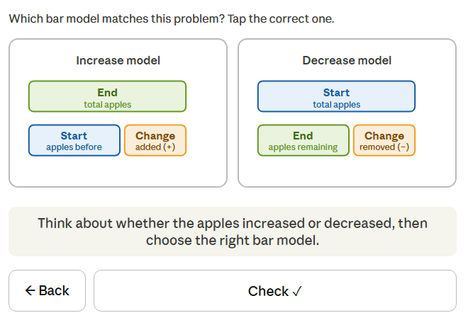
2b. Identify the right bar model

Slide 5
Practice-flow
Identify Variables can be made as a separate module, similar to Combine schema
Combine 2a, 2b into a single module and for each question both the parts (2a and 2b) has to be completed inorder to count towards mastery.
That is, each question in this module consists of doing the parts 2a – 2b.
A question is correctly answered if both the parts are correct.
Since there are only 2 options for questions in 2a and 2b, there is no need to provide Retry/Reveal Answer for incorrect response. On submit of wrong answer just mark the selected option as wrong with red and right as green in the same screen with next problem button.
If the answer to 2a is incorrect, don’t proceed to the 2b part. Instead provide a new problem with the 2a part.

Slide 6
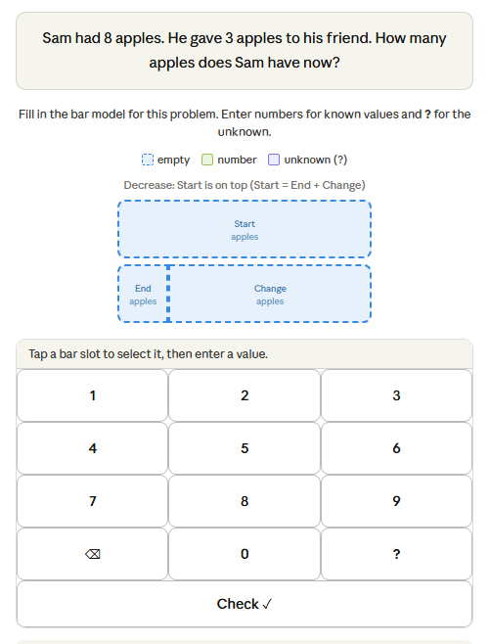
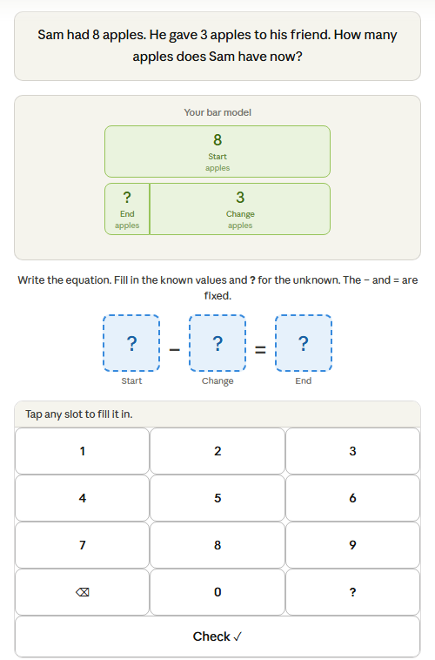
3. Fill the bar model
4. Fill the equation

Slide 7
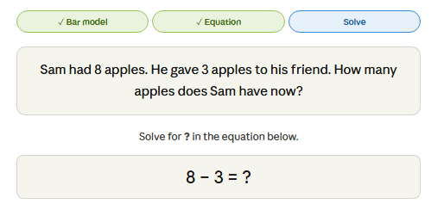
5. Full integration
Unlike the combine schema, here in full integration module, there will be 4 steps. 1. identify the change and identify the right bar model as one step.
2. Bar model creation from word problem
3. Equation building from bar model
4. Solve for the final answer
All 4 steps have to be answered correctly for each question to count towards mastery.
All 4 steps have to be of the same question not different.
Wrong answer in the intermediate doesn’t skip to new question. Goes through all steps even it doesn’t count towards mastery.

